Slide 1

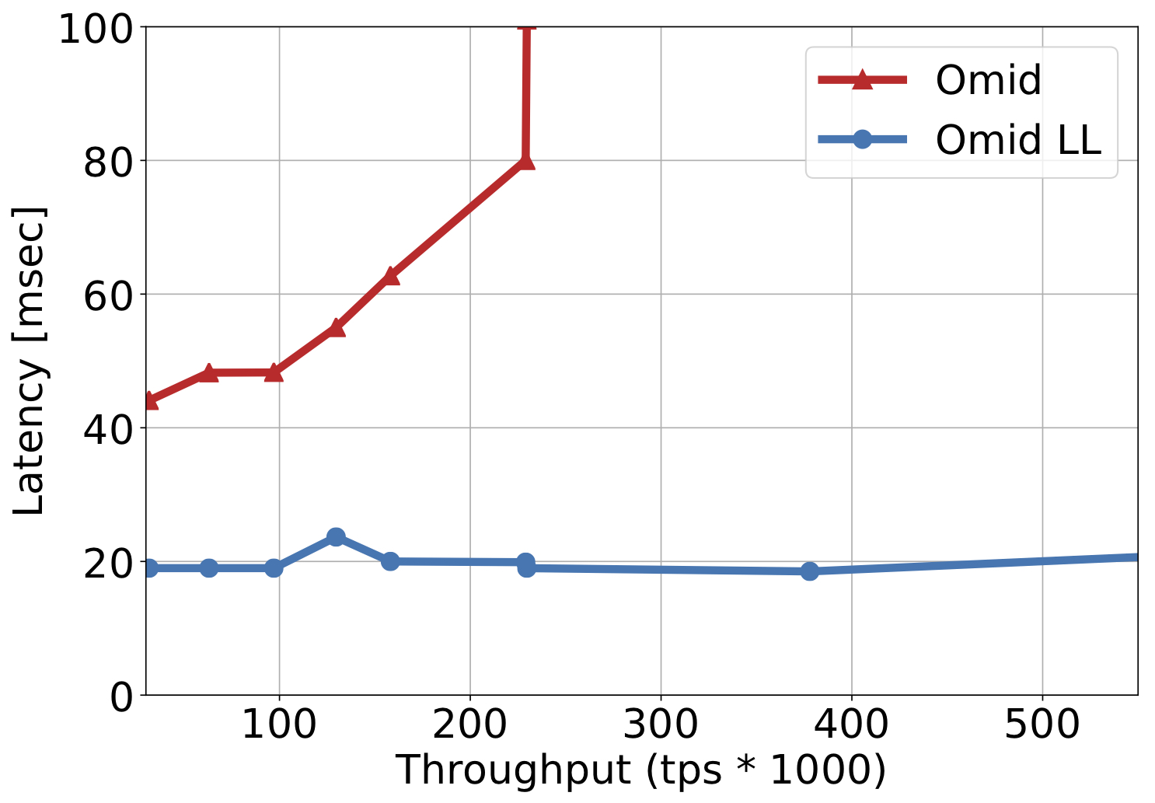
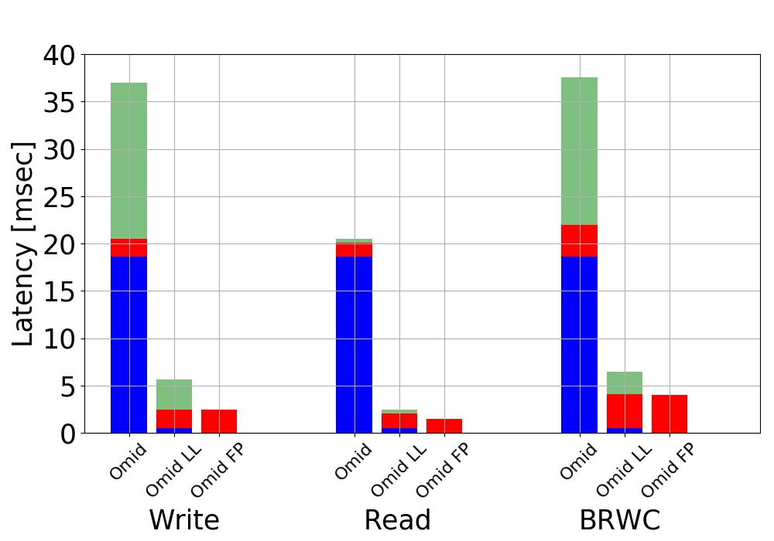
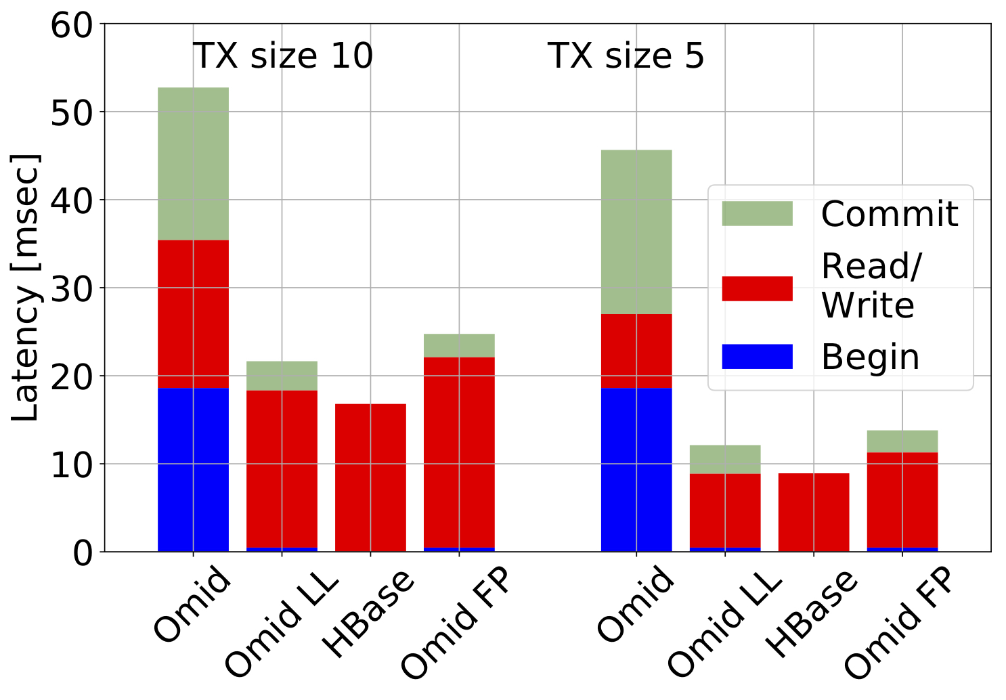

Taking Omid to the Clouds: Fast, Scalable Transactions for Real-Time Cloud Analytics
O. Shacham • Y. Gottesman • A. Bergman • E. Bortnikov • E. Hillel • I. Keidar
Yahoo Research
Omid
C – centralized, D – distributed
Phoenix Integration
Transactional API over NoSQL key value
Client Library + Runtime Service
Open source – Apache incubator
Implemented over Apache HBase
Snapshot Isolation consistency
Highly Available
Originally optimized for throughput
Omid Design Choices
Secondary index creation
When a new index is created, two coprocessors are installed:
Populates new index with history
Maintains index by augmenting write to table with a write to index
Beyond snapshot isolation - SIX
System | Validation | Commit entry writes | Multi tenancy
Perculator (2PC) | D | D | no
CockroachDB | D | D | yes
Omid | C | C | yes
Omid LL | C | D | yes
CREATE INDEX
start
CREATE INDEX complete
TX1 – cop A
Omid fence API
TX3 – cop B
TX2 - Abort
Optimized for low latency – Omid LL
Redesign Omid to eliminate key bottleneck
Distribute commit table updates among clients.
Novel Fast Path API – Omid FP
Many workloads have single key transactions
Eliminate transaction overhead for them
Direct access to region server without access to TM
API:
brc(key) • bwc(key,value) • br(key) + wc(key,val)
Apache Phoenix Integration
Integrate Omid as the transactional
layer in Phoenix SQL engine
Taking Omid To The Cloud
Omid Architecture
Client
API
Begin/Commit
Transaction Manager
INSERT INTO T
SELECT ID+10 FROM T;
INSERT INTO T
SELECT ID+100 FROM T;
Put/Get/ Fast path
Removed in omid-LL
checkpoint
Put
checkpoint
key | version | value | commit ts
k | 5 | a | 7
k | 8 | b | ?
txid | commit ts
5 | 7
Data Tables
Commit Table
Performance

